Slide 1
Hashing
By Dr. Nagaratna P Hegde

Slide 2
What Is Hashing?
Method to locate data quickly
  Ideally has O(1) search times
  Yet cannot do easy traversal of data items
Technique that determines index using only a search key
Hash function locates correct item in hash table
  Maps or “hashes to” entry
Copyright ©2012 by Pearson Education, Inc. All rights reserved

Slide 3
Typical Hashing
Algorithm will
  Convert search key to integer called hash code.
  Compress hash code into range of indices for hash table.
Typical hash functions not perfect
  Can allow more than one search key to map into single index
  Causes “collision” in hash table
Copyright ©2012 by Pearson Education, Inc. All rights reserved

Slide 4
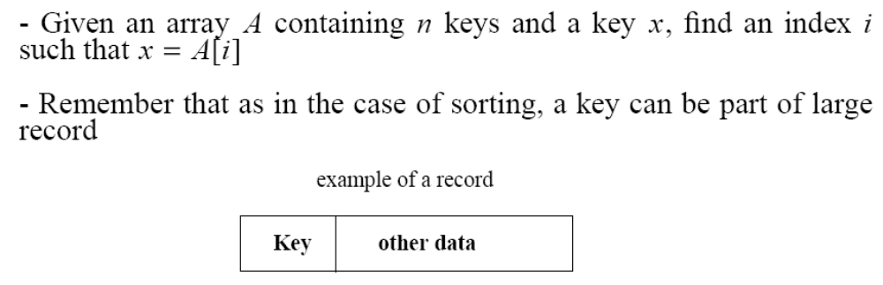
The Search Problem
Find items with keys matching a given search key
  Given an array A, containing n keys, and a search key x, find the index i such as x=A[i]
  As in the case of sorting, a key could be part of a large record.

Slide 5
Applications
Keeping track of customer account information at a bank
  Search through records to check balances and perform transactions
Keep track of reservations on flights
  Search to find empty seats, cancel/modify reservations
Search engine
  Looks for all documents containing a given word

Slide 6
Hash Tables
When K is much smaller than U, a hash table requires much less space than a direct-address table
  Can reduce storage requirements to |K|
  Can still get O(1) search time, but on the average case, not the worst case

Slide 7
Hash Tables
Idea:
  Use a function h to compute the slot for each key
  Store the element in slot h(k)
A hash function h transforms a key into an index in a hash table T[0…m-1]:
h : U → {0, 1, . . . , m - 1}
We say that k hashes to slot h(k)
Advantages:
  Reduce the range of array indices handled: m instead of |U|
  Storage is also reduced

Slide 8
Example: HASH TABLES
0
U
(universe of keys)
h(k₁)
h(k₄)
k₁
K
(actual
keys)
k₄
k₂
h(k₂) = h(k₅)
k₅
k₃
h(k₃)
m - 1

Slide 9
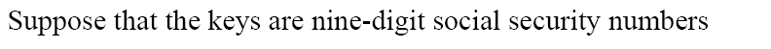

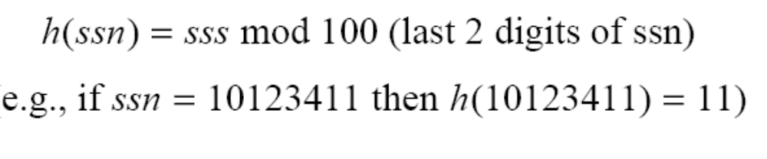
Revisit Example 2

Slide 10
Do you see any problems with this approach?
0
U
(universe of keys)
h(k₁)
h(k₄)
k₁
K
(actual
keys)
k₄
k₂
h(k₂) = h(k₅)
Collisions!
k₅
k₃
h(k₃)
m - 1

Slide 11
Collisions
Two or more keys hash to the same slot!!
For a given set K of keys
  If |K| ≤ m, collisions may or may not happen, depending on the hash function
  If |K| > m, collisions will definitely happen (i.e., there must be at least two keys that have the same hash value)
Avoiding collisions completely is hard, even with a good hash function

Slide 12
Handling Collisions
We will review the following methods:
  Chaining
  Open addressing
    Linear probing
    Quadratic probing
    Double hashing
We will discuss chaining first, and ways to build “good” functions.

Slide 13
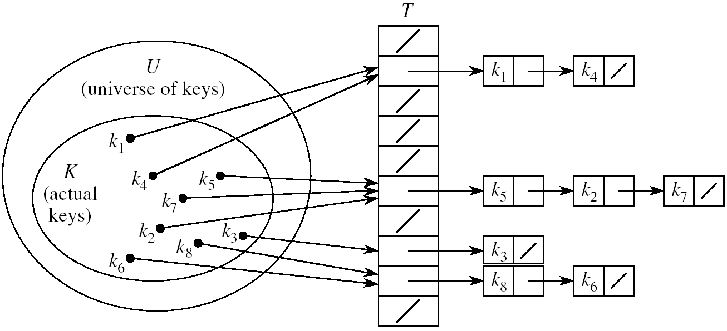
Handling Collisions Using Chaining
Idea:
  Put all elements that hash to the same slot into a linked list
  Slot j contains a pointer to the head of the list of all elements that hash to j

Slide 14
Collision with Chaining - Discussion
Choosing the size of the table
  Small enough not to waste space
  Large enough such that lists remain short
  Typically 1/5 or 1/10 of the total number of elements
How should we keep the lists: ordered or not?
  Not ordered!
    Insert is fast
    Can easily remove the most recently inserted elements

Slide 15
Insertion in Hash Tables
Alg.: CHAINED-HASH-INSERT(T, x)
insert x at the head of list T[h(key[x])]
Worst-case running time is O(1)
Assumes that the element being inserted isn’t already in the list
It would take an additional search to check if it was already inserted

Slide 16
Deletion in Hash Tables
Alg.: CHAINED-HASH-DELETE(T, x)
delete x from the list T[h(key[x])]
Need to find the element to be deleted.
Worst-case running time:
  Deletion depends on searching the corresponding list

Slide 17
Searching in Hash Tables
Alg.: CHAINED-HASH-SEARCH(T, k)
search for an element with key k in list T[h(k)]
Running time is proportional to the length of the list of elements in slot h(k)

Slide 18
Hash Functions
A hash function transforms a key into a table address
What makes a good hash function?
  (1) Easy to compute
  (2) Approximates a random function: for every input, every output is equally likely (simple uniform hashing)
In practice, it is very hard to satisfy the simple uniform hashing property
  i.e., we don’t know in advance the probability distribution that keys are drawn from

Slide 19
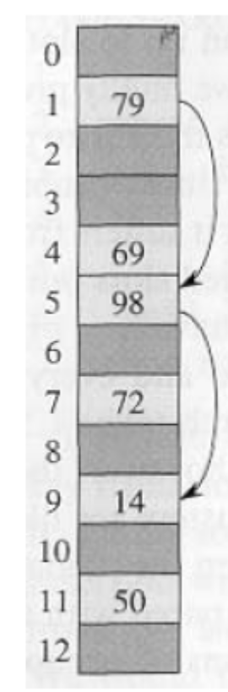
Open Addressing
If we have enough contiguous memory to store all the keys (m > N) ⇒ store the keys in the table itself
No need to use linked lists anymore
Basic idea:
  Insertion: if a slot is full, try another one,
  until you find an empty one
  Search: follow the same sequence of probes
  Deletion: more difficult ... (we’ll see why)
Search time depends on the length of the
probe sequence!
e.g., insert 14

Slide 20
Generalize hash function notation:
A hash function contains two arguments now:
  (i) Key value, and (ii) Probe number
  h(k,p), p=0,1,...,m-1
Probe sequences
<h(k,0), h(k,1), ..., h(k,m-1)>
  Must be a permutation of <0,1,...,m-1>
  There are m! possible permutations
  Good hash functions should be able to
  produce all m! probe sequences
insert 14
Example
<1, 5, 9>

Slide 21
Common Open Addressing Methods
Linear probing
Quadratic probing
Double hashing
Note: None of these methods can generate more than m² different probing sequences!

Slide 22
Linear probing: Inserting a key
Idea: when there is a collision, check the next available position in the table (i.e., probing)
h(k,i) = (h₁(k) + i) mod m
i=0,1,2,...
First slot probed: h₁(k)
Second slot probed: h₁(k) + 1
Third slot probed: h₁(k)+2, and so on
Can generate m probe sequences maximum, why?
probe sequence: < h1(k), h1(k)+1 , h1(k)+2 , ....>
wrap around

Slide 23
Linear probing: Searching for a key
Three cases:
  (1) Position in table is occupied with an element of equal key
  (2) Position in table is empty
  (3) Position in table occupied with a different element
Case 2: probe the next higher index until the element is found or an empty position is found
The process wraps around to the beginning of the table
0
h(k₁)
h(k₄)
h(k₂) = h(k₅)
h(k₃)
m - 1

Slide 24
Separate Chaining
All keys that map to the same
table location are kept in a linked list (a.k.a. a "chain" or "bucket")
As easy as it sounds
Example:
insert 10, 22, 86, 12, 42
with h(x) = x % 10
0 | /
1 | /
2 | /
3 | /
4 | /
5 | /
6 | /
7 | /
8 | /
9 | /
July 9, 2012
CSE 332 Data Abstractions, Summer 2012

Slide 25
Separate Chaining
All keys that map to the same
table location are kept in a linked list (a.k.a. a "chain" or "bucket")
As easy as it sounds
Example:
insert 10, 22, 86, 12, 42
with h(x) = x % 10
0
1 | /
2 | /
3 | /
4 | /
5 | /
6 | /
7 | /
8 | /
9 | /
10
/
July 9, 2012
CSE 332 Data Abstractions, Summer 2012

Slide 26
Separate Chaining
All keys that map to the same
table location are kept in a linked list (a.k.a. a "chain" or "bucket")
As easy as it sounds
Example:
insert 10, 22, 86, 12, 42
with h(x) = x % 10
0
1 | /
2
3 | /
4 | /
5 | /
6 | /
7 | /
8 | /
9 | /
10
/
22
/
July 9, 2012
CSE 332 Data Abstractions, Summer 2012

Slide 27
Separate Chaining
All keys that map to the same
table location are kept in a linked list (a.k.a. a "chain" or "bucket")
As easy as it sounds
Example:
insert 10, 22, 86, 12, 42
with h(x) = x % 10
0
1 | /
2
3 | /
4 | /
5 | /
6
7 | /
8 | /
9 | /
10
/
22
/
86
/
July 9, 2012
CSE 332 Data Abstractions, Summer 2012

Slide 28
Separate Chaining
All keys that map to the same
table location are kept in a linked list (a.k.a. a "chain" or "bucket")
As easy as it sounds
Example:
insert 10, 22, 86, 12, 42
with h(x) = x % 10
0
1 | /
2
3 | /
4 | /
5 | /
6
7 | /
8 | /
9 | /
10
/
12
22
/
86
/
July 9, 2012
CSE 332 Data Abstractions, Summer 2012

Slide 29
Separate Chaining
All keys that map to the same
table location are kept in a linked list (a.k.a. a "chain" or "bucket")
As easy as it sounds
Example:
insert 10, 22, 86, 12, 42
with h(x) = x % 10
0
1 | /
2
3 | /
4 | /
5 | /
6
7 | /
8 | /
9 | /
10
/
42
12
22
/
86
/
CSE 332 Data Abstractions, Summer 2012

Slide 30
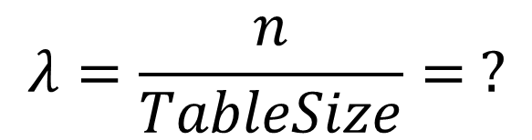
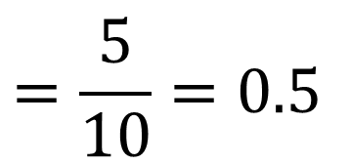
Load Factor?
0
1 | /
2
3 | /
4 | /
5 | /
6
7 | /
8 | /
9 | /
10
/
42
12
22
/
86
/
July 9, 2012
CSE 332 Data Abstractions, Summer 2012

Slide 31
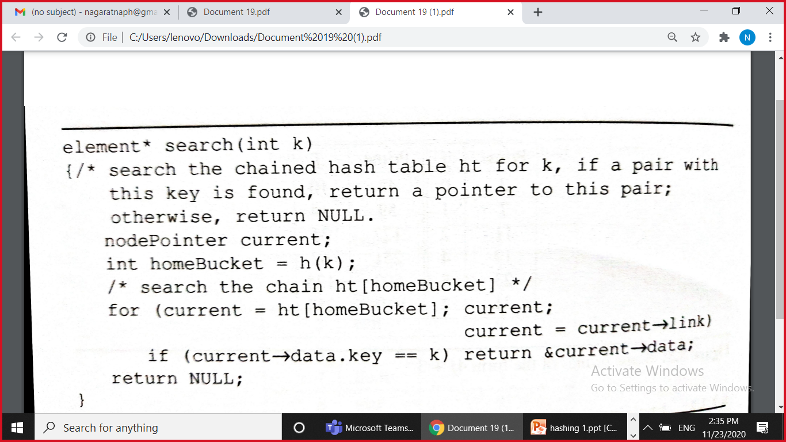

Slide 32
Linear Probing
If the current location is used, try the next table location
  linear_probing_insert(K)
  if (table is full) error
  probe = h(K)
  while (table[probe] occupied)
  probe = (probe + 1) mod M
  table[probe] = K
Lookups walk along table until the key or an empty slot is found
Uses less memory than chaining. (Don’t have to store all those links)
Slower than chaining. (May have to walk along table for a long way.)
Deletion is more complex. (Either mark the deleted slot or fill in the slot by shifting some elements down.)

Slide 33
Open Addressing: Linear Probing
Separate chaining does not use all the space in the table. Why not use it?
Store directly in the array cell
No linked lists or buckets
How to deal with collisions?
If h(key) is already full,
try (h(key) + 1) % TableSize. If full,
try (h(key) + 2) % TableSize. If full,
try (h(key) + 3) % TableSize. If full…
Example: insert 38, 19, 8, 79, 10
0
1
2
3
4
5
6
7
8
9
July 9, 2012
CSE 332 Data Abstractions, Summer 2012

Slide 34
Open Addressing: Linear Probing
Separate chaining does not use all the space in the table. Why not use it?
Store directly in the array cell (no linked list or buckets)
How to deal with collisions?
If h(key) is already full,
try (h(key) + 1) % TableSize. If full,
try (h(key) + 2) % TableSize. If full,
try (h(key) + 3) % TableSize. If full…
Example: insert 38, 19, 8, 79, 10
0
1
2
3
4
5
6
7
8 | 38
9
July 9, 2012
CSE 332 Data Abstractions, Summer 2012

Slide 35
Open Addressing: Linear Probing
Separate chaining does not use all the space in the table. Why not use it?
Store directly in the array cell
(no linked list or buckets)
How to deal with collisions?
If h(key) is already full,
try (h(key) + 1) % TableSize. If full,
try (h(key) + 2) % TableSize. If full,
try (h(key) + 3) % TableSize. If full…
Example: insert 38, 19, 8, 79, 10
0
1
2
3
4
5
6
7
8 | 38
9 | 19
July 9, 2012
CSE 332 Data Abstractions, Summer 2012

Slide 36
Open Addressing: Linear Probing
Separate chaining does not use all the space in the table. Why not use it?
Store directly in the array cell
(no linked list or buckets)
How to deal with collisions?
If h(key) is already full,
try (h(key) + 1) % TableSize. If full,
try (h(key) + 2) % TableSize. If full,
try (h(key) + 3) % TableSize. If full…
Example: insert 38, 19, 8, 79, 10
0 | 8
1
2
3
4
5
6
7
8 | 38
9 | 19
July 9, 2012
CSE 332 Data Abstractions, Summer 2012

Slide 37
Open Addressing: Linear Probing
Separate chaining does not use all the space in the table. Why not use it?
Store directly in the array cell
(no linked list or buckets)
How to deal with collisions?
If h(key) is already full,
try (h(key) + 1) % TableSize. If full,
try (h(key) + 2) % TableSize. If full,
try (h(key) + 3) % TableSize. If full…
Example: insert 38, 19, 8, 79, 10
0 | 8
1 | 79
2
3
4
5
6
7
8 | 38
9 | 19
July 9, 2012
CSE 332 Data Abstractions, Summer 2012

Slide 38
Open Addressing: Linear Probing
Separate chaining does not use all the space in the table. Why not use it?
Store directly in the array cell
(no linked list or buckets)
How to deal with collisions?
If h(key) is already full,
try (h(key) + 1) % TableSize. If full,
try (h(key) + 2) % TableSize. If full,
try (h(key) + 3) % TableSize. If full…
Example: insert 38, 19, 8, 79, 10
0 | 8
1 | 79
2 | 10
3
4
5
6
7
8 | 38
9 | 19
July 9, 2012
CSE 332 Data Abstractions, Summer 2012

Slide 39
Load Factor?
0 | 8
1 | 79
2 | 10
3
4
5
6
7
8 | 38
9 | 19
Can the load factor when using linear probing ever exceed 1.0?
Nope!!
July 9, 2012
CSE 332 Data Abstractions, Summer 2012

Slide 40
Open Addressing in General
This is one example of open addressing
Open addressing means resolving collisions by trying a sequence of other positions in the table
Trying the next spot is called probing
We just did linear probing
h(key) + i) % TableSize
In general have some probe function f and use h(key) + f(i) % TableSize
Open addressing does poorly with high load factor λ
So we want larger tables
Too many probes means we lose our O(1)
July 9, 2012
CSE 332 Data Abstractions, Summer 2012

Slide 41
